Slide 1
Minesweeper Lab
Slides and Assignment
By: Austin Crapo
Date: June 2017

Slide 2
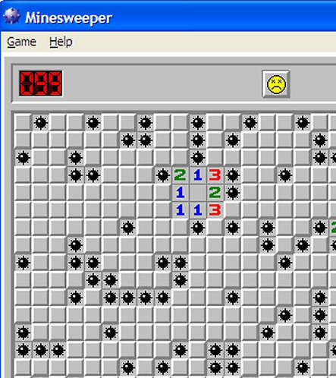
Picture taken from http://www.wikihow.com/Cheat-at-Minesweeper July 19 2017 and used under fair use
What is it?
The original and most basic version of the game was called ‘Cube’ and was published in the 1960’s
The concept was refined and caught on as a successful puzzle game in the 1970’s
A player must reveal all empty tiles on a grid.
A revealed empty tile states how many of its 8 neighbors contain a bomb.
Revealing an empty tile where all neighbors are also empty reveals all its neighbors.
If a player reveals a bomb, they lose.
A running timer gives time pressure.
If the timer runs out before the last empty tile is revealed, all the bombs ‘go off’ and the player loses.

Slide 3
GLIM
Graphics Library for MIPS
Graphics are provided via the terminal
GLIM is a library that uses terminal ‘escape sequences’ to print characters to arbitrary positions with one of 256 colors.
Almost all the code to handle graphics is provided in the file common.s.
The solution only used the library to print a win or lose statement at the end of the game.

Slide 4
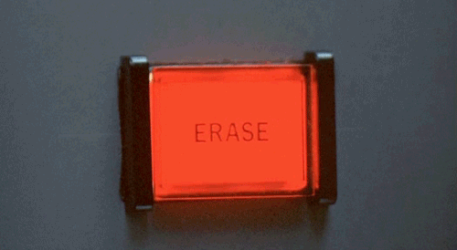
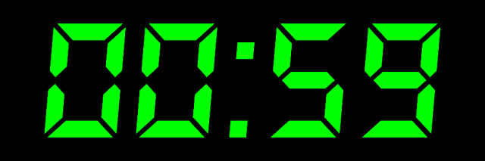
MIPS Interrupts
Asynchronous code segments that:
Run when a specific signal occurs
Run immediately
What are interrupts?
Keyboard Interrupts:
Run when a key is pressed
Timer Interrupts:
Run when a timer goes off
Timer gif from: http://amightynut.blogspot.ca/2013/12/animated-gif-digital-timer.html

Slide 5
Coprocessor 0
This counter is incremented
every 10ms
Timer Counter
Status Register
Coprocessor 0
$12
Cause Register
$13
$9
$14
$11
EPC
When the counter is
equal the compare value
an exception is generated
Timer Compare
TODO: add basic operation of timer.
Notes:
This and the remaining slides are graphical explanations of using the coprocessor for interrupts. Provided by J. Nelson Amaral. For questions on slide meanings and to see the portions that deal with the display interrupts, please speak with him.

Slide 6
Keyboard
Enable Keyboard
Interruptions
0xffff 0000
0xffff 0004
Exception
Handler
Control Register
Data Register
Initialize
Status Register
Coprocessor 0
$12
main
$13
$9
Initialize
Clock
$14
$11

Slide 7
Keyboard
Read
Keyboard
Data
0xffff 0000
0xffff 0004
Exception
Handler
Control Register
Data Register
Keyboard
Interrupt
Coprocessor 0
$12
main
$13
$9
000
001
010
011
100
101
110
111
000
001
010
011
100
101
110
$14
$11

Slide 8
Is it “q”, something else?
Do the right thing.
Keyboard
Re-enable
Keyboard
Interrupts
0xffff 0000
0xffff 0004
Exception
Handler
Control Register
Data Register
Reset
Status
and
Cause
Register
Coprocessor 0
$12
main
$13
$9
000
001
010
011
100
101
110
111
000
001
010
011
100
101
110
$14
$11

Slide 9
Keyboard
0xffff 0000
0xffff 0004
Reset
Timer
Exception
Handler
Control Register
Data Register
Reset
Status
and
Cause
Register
Timer
Interrupt
Coprocessor 0
$12
main
$13
$9
000
001
010
011
100
101
110
111
000
001
010
011
100
101
110
$14
$11

Slide 10
The Assignment – common.s
Number of rows for this session: 20
Number of columns for this session: 40
Random seed to use: 5
Number of bombs for this session: 100

Slide 11
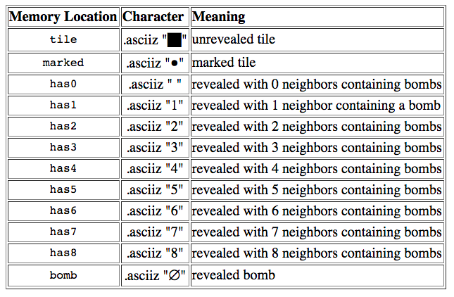
List of Characters

Slide 12
Address of
character that
represents the tile
row
getTile
col
?
State of
the tile

Slide 13
row
1: has bomb
0: has no bomb
hasBomb
col

Slide 14
row
setBomb
col

Slide 15
prepareBoard
Invoked once after setting bombs.
May or may not be needed.

Slide 16
row
printTile
col

Slide 17
main
(and exception handler)
See specification in lab instructions.

Slide 18
